Slide 1
Floyd-Warshall Algorithm
All pair shortest path algorithm

Slide 2
Table of Contents
Introduction
Pseudocode
Time complexity
Comparison
Application
Implementation
GitHub

Slide 3
Introduction
Definition
The Floyd-Warshall Algorithm is a dynamic programming algorithm used to find the shortest paths between all pairs of vertices in a weighted graph. It works for graphs with both positive and negative edge weights.
Key features
Purpose
Finds the shortest paths between all pairs of vertices in a weighted graph.
Dynamic programming
Uses a step-by-step process to build solutions for smaller subproblems, eventually solving the overall problem.
Input
A weighted graph represented by its adjacency matrix.
Output
A matrix containing the shortest path distances between all pairs of vertices.

Slide 4
Floyd Warshall algorithm
Initialize the solution matrix same as the input graph matrix as a first step.
Then update the solution matrix by considering all vertices as an intermediate vertex.
The idea is to pick all vertices one by one and updates all shortest paths which include the picked vertex as an intermediate vertex in the shortest path.
When we pick vertex number k as an intermediate vertex, we already have considered vertices {0, 1, 2, .. k-1} as intermediate vertices.
For every pair (i, j) of the source and destination vertices respectively, there are two possible cases.
k is not an intermediate vertex in shortest path from i to j. We keep the value of dist[i][j] as it is.
k is an intermediate vertex in shortest path from i to j. We update the value of dist[i][j] as dist[i][k] + dist[k][j], if dist[i][j] > dist[i][k] + dist[k][j]

Slide 5



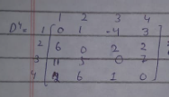
Working with example
Weighted positive graph
Weighted positive negative graph.

Slide 6
Pseudocode
For(k=1 to 4) for D1 , D2 , D3 , D4
{
for(i=1 to 4)
{
for(j=1 to 4)
Distance[i][j] = minimum (Distance[i][j], Distance[i][k] + Distance[k][j])
}
}
where i = source Node, j = Destination Node, k = Intermediate Node

Slide 7
Time complexity
Time complexity depends on the number of problems and sub-problems because we have to calculate shortest path of every node (n) . Suppose the size of any matrix is n*n= n2 (n2 sub-problems) . And we also know every new distance[][] for any i and j depends on the distance calculated in earlier steps e.g., D1 depends on D0 , D2 depends on D1 , D3 depends on D4 . So, we have to work on every Metrix n2 *n e.g., n where n is total number of Metrix . So the time complexity becomes O(n3).
For space complexity, we have n matrix and each matrix size is n2 . So its space complexity will be O(n3). But we can also refined this by saying that n2 is the space of matrix but rather than taking all matrixes we take the currently using matrixes , which will be reduce to 2 matrixes at a time. So the space complexity will be O(n2).

Slide 8
Running time
The running time of the Floyd-Warshall algorithm is O(V3) where V is the number of vertices in the graph.
Reason for O(V3)
Outer Loop Over Intermediate Nodes:
The algorithm iterates through all vertices as potential intermediate nodes.
This loop runs V times.
Nested Loops Over Source and Destination Nodes:
For each intermediate node , the algorithm considers every pair of source (i) and destination (j) nodes.
Both i and j iterate over all V vertices, resulting in V2 iterations for these nested loops.
Constant Time Update for Each Pair:
Inside the innermost loop, the algorithm updates the distance Distance[i][j] by comparing two values: Distance[i][j] and Distance[i][D]+Distance[D][j].
This operation takes O(1) time.
Thus, the total time complexity is:
O(V)×O(V2)×O(1)=O(V3)

Slide 9
Comparison
Comparison of Floyd -Warshall with other algorithm like:
Bellman-Ford Algorithm
Dijkstra's Algorithm
Johnson's Algorithm

Slide 10
Dijkstra's Algorithm, Bellmen-Ford Algorithm, Johnson's Algorithm comparison with Floyd-Warshall Algorithm
 | Dijkstra's Algorithm | Bellmen-Ford Algorithm | Johnson's Algorithm
Purpose | Single source shortest paths | Single-source shortest paths. | solve all-pairs shortest paths.
Time Complexity | O(V2) | O(V⋅E). | O(V⋅E+V2logV).
Graph type | No support for negative cycles | support negative weights (no negative cycles). | support negative weights (no negative cycles).
Use cases | Sparse graph | Sparse graphs or cycle detection. | Sparse graphs (optimized using reweighting).

Slide 11
Real time Applications
Applications
Network Routing:
Finds the shortest paths in computer networks to optimize data packet routing.
Transportation Systems:
Calculates the shortest routes between cities in road or rail networks.
Social Network Analysis:
Determines the shortest connections or degrees of separation between users.
Graph Analysis:
Used in dependency resolution, such as in compilers or task scheduling.

Slide 12
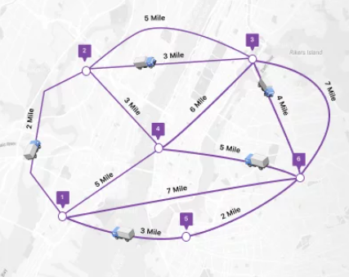
Application Example: Shortest Path in a City Map

Slide 13
INF = float('inf')
vertices = 4 # Number of cities
def floyd_warshall(graph):
# Initialize the distance matrix
distance_between_vertices = [[INF] * vertices for _ in range(vertices)]
# Copy the input graph to the distance matrix
for i in range(vertices):
for j in range(vertices):
distance_between_vertices[i][j] = graph[i][j]
# Set the distance to self as 0
for i in range(vertices):
distance_between_vertices[i][i] = 0
# Main algorithm
for k in range(vertices):
for i in range(vertices):
for j in range(vertices):
distance_between_vertices[i][j] = min(
distance_between_vertices[i][j],
distance_between_vertices[i][k] +
distance_between_vertices[k][j]
)
print_shortest_paths(distance_between_vertices)
def print_shortest_paths(distance):
print("Following shows the shortest path between all the pairs of cities:")
for i in range(vertices):
for j in range(vertices):
print(f"The shortest distance between city {i + 1} and city {j + 1} is", end=" ")
if distance[i][j] == INF:
print("INF")
else:
print(distance[i][j])
print(" ")
# Example graph representing distances between cities
# Here, the graph is represented as an adjacency matrix
graph = [
[0, 3, INF, 5], # Distances from city 1
[2, 0, INF, 4], # Distances from city 2
[INF, 1, 0, INF], # Distances from city 3
[INF, INF, 2, 0] # Distances from city 4
]
# Run the Floyd-Warshall algorithm
floyd_warshall(graph)

Slide 14
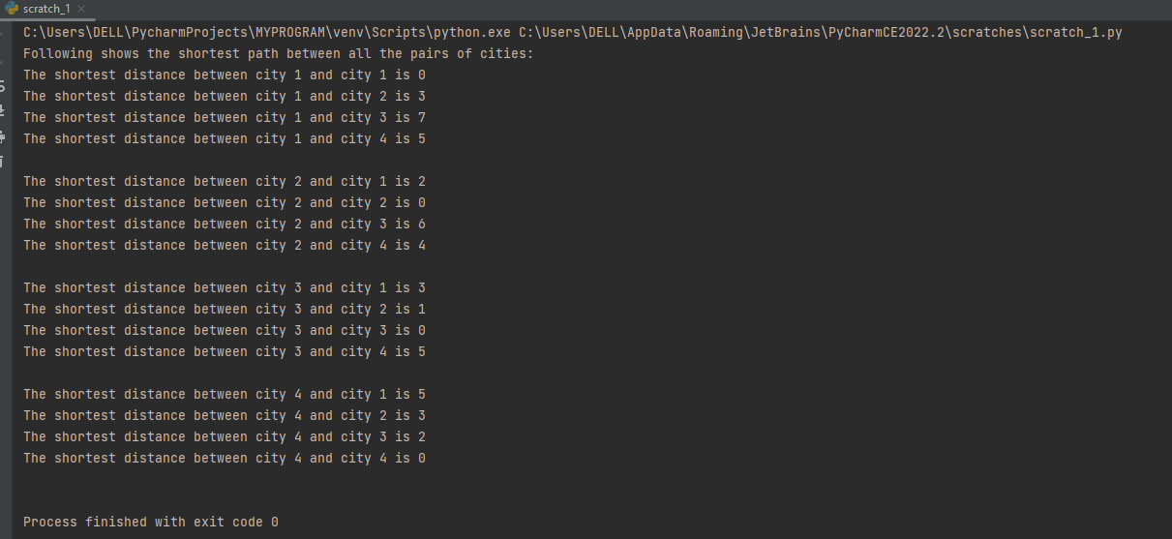
Output :

Slide 15
Uploaded
https://github.com/Kashaf313/floyd_warshall-Algorithm

